Slide 1

Classifying driver behaviour using a mobile phone, the social web and LOD
by the Linked Otters
Powerpoint Templates

Slide 2
Outline
Context
State of the art
Our proposal
Example
Final thoughts

Slide 3

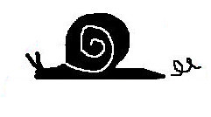
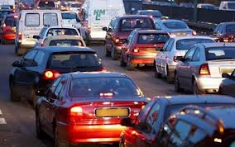



Context

Slide 4
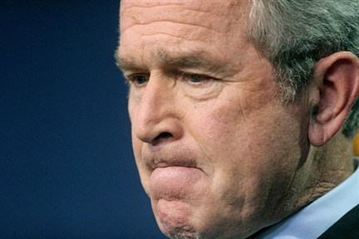
State of the art
[1] « Ontology rules are very cool, but … » - Fabio
[2] « I don’t believe in it. » - Fabio
[3] « Statistical methods are more efficient and scalable » - Fabio
[4] « But ontology rules are really cool, so we do it anyway » - us
[5] « I need a coffee… » - Fabio

Slide 5
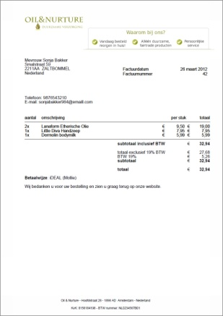

Our proposal
LOD
Static
Dynamic
Insurance Company
Risk factor

Slide 6


Our proposal
Weather data
Traffic data
Map data
Accident reports
name
age
car model
...
total kms per year?
commuter?
frequent pub visitor?
often in traffic jams?
likes to accelerate fast?
...
Insurance company
Short term historical database
3 months
10 min
1 min
ID
location
speed
acceleration
tip/tilt
aggregations
Real-time
phone data (.5 seconds)
Rules engine (.5 seconds)
Long term historical database
Country profile (static)
Driver profiles
Statistical analysis
Risk factors

Slide 7
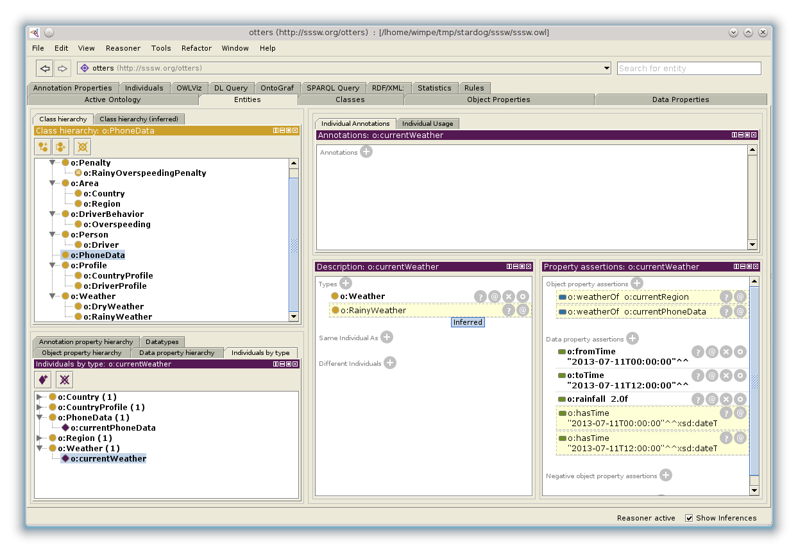
Example
Otters ontology
o:Weather(?weather), o:rainfall(?weather, ?rainfall), o:weatherOf(?weather, ?region), o:partOf(?region, ?country), o:hasCountryProfile(?country, ?profile), o:rainyLimit(?profile, ?limit), greaterThan(?r,?limit) -> o:RainyWeather(?w)

Slide 8
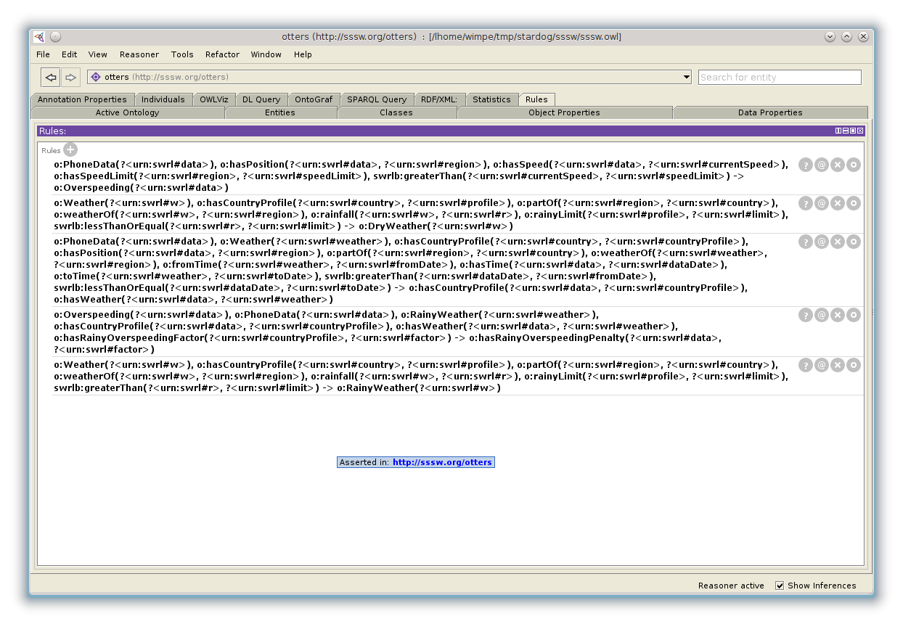
Example

Slide 9
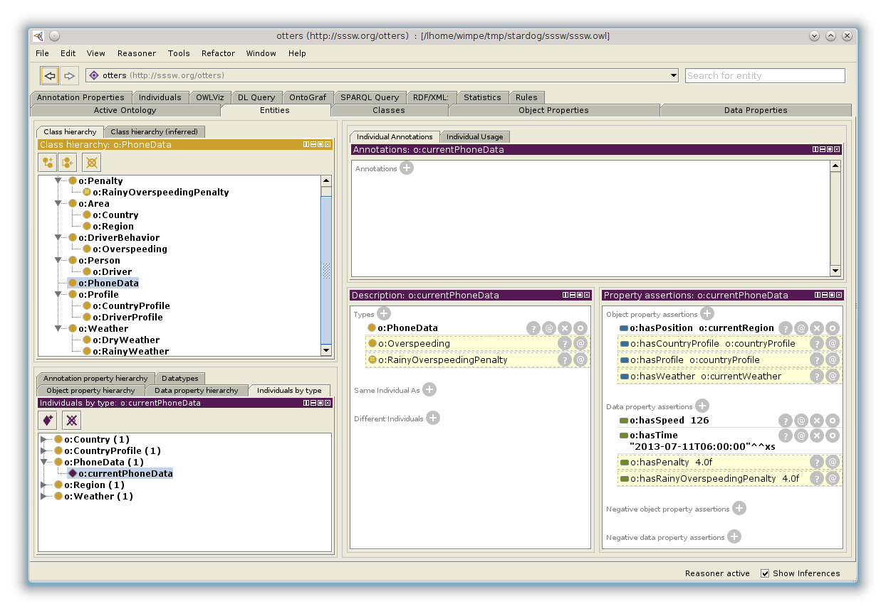
Example

Slide 10
Final thoughts
More statistics to be derived
LOD informations extraction
Experiments
Continue sleeping …

